Slide 1
Help Wanted Online A real-time measure of job postings
September 2024
Office of Research Connecticut Department of Labor
Connecticut Department of Labor – Research Office 200 Folly Brook Blvd. Wethersfield, CT 06109
Help Wanted Online

Slide 2
What is HWOL?
The Conference Board Help Wanted Online® Data Series (HWOL) measures the number of new, first-time Online job postings and jobs reposted from the previous month for over 50,000 Internet job boards, corporate boards and smaller job sites that serve niche markets and smaller geographic areas. This document contains information on monthly total job ad counts for August 2024.
Connecticut Department of Labor – Research Office 200 Folly Brook Blvd. Wethersfield, CT 06109
Help Wanted Online

Slide 3
Upcoming Release Dates
Monthly Report: October 16th, 2024 Weekly New Ads Report: Updated every Tuesday
Connecticut Department of Labor – Research Office 200 Folly Brook Blvd. Wethersfield, CT 06109
Help Wanted Online

Slide 4
Statewide Weekly HWOL New Job Ads
Information on weekly new job ads by Employer, Industry, and Occupation can be found at: https://www1.ctdol.state.ct.us/lmi/hwol.asp This Information is updated every Tuesday.
Connecticut Department of Labor – Research Office 200 Folly Brook Blvd. Wethersfield, CT 06109
Help Wanted Online

Slide 5
Statewide Monthly Highlights
- Total postings in Connecticut was 82,219 in August 2024, up from a July 2024 posting count of 89,159. -Industry sectors with the most job postings were Health Care and Social Assistance (16,456 postings), Retail Trade (9,132 posting), Manufacturing (6,494 postings), and Finance & Insurance (5,254 postings).
-Occupations with the most postings were Registered Nurses (4,639 postings), Retail Salespersons (3,264 postings), Home Health & Personal Care Aides (2,204 postings), and Supervisors of Retail Sales Workers (1,825 postings).
Connecticut Department of Labor – Research Office 200 Folly Brook Blvd. Wethersfield, CT 06109
Help Wanted Online

Slide 6
Top Qualifications in Connecticut Job Ads
Connecticut Department of Labor – Research Office 200 Folly Brook Blvd. Wethersfield, CT 06109
Help Wanted Online

Slide 7
Top Skills in Connecticut Job Ads
Connecticut Department of Labor – Research Office 200 Folly Brook Blvd. Wethersfield, CT 06109
Help Wanted Online

Slide 8
Connecticut Department of Labor – Research Office 200 Folly Brook Blvd. Wethersfield, CT 06109
Help Wanted Online

Slide 9
Connecticut Employers with the Most Job Ads
Connecticut Department of Labor – Research Office 200 Folly Brook Blvd. Wethersfield, CT 06109
Help Wanted Online

Slide 10
Connecticut Occupations with the Most Job Ads
Connecticut Department of Labor – Research Office 200 Folly Brook Blvd. Wethersfield, CT 06109
Help Wanted Online

Slide 11
Top Occupations in Industries With The Most Ads
Connecticut Department of Labor – Research Office 200 Folly Brook Blvd. Wethersfield, CT 06109
Help Wanted Online

Slide 12
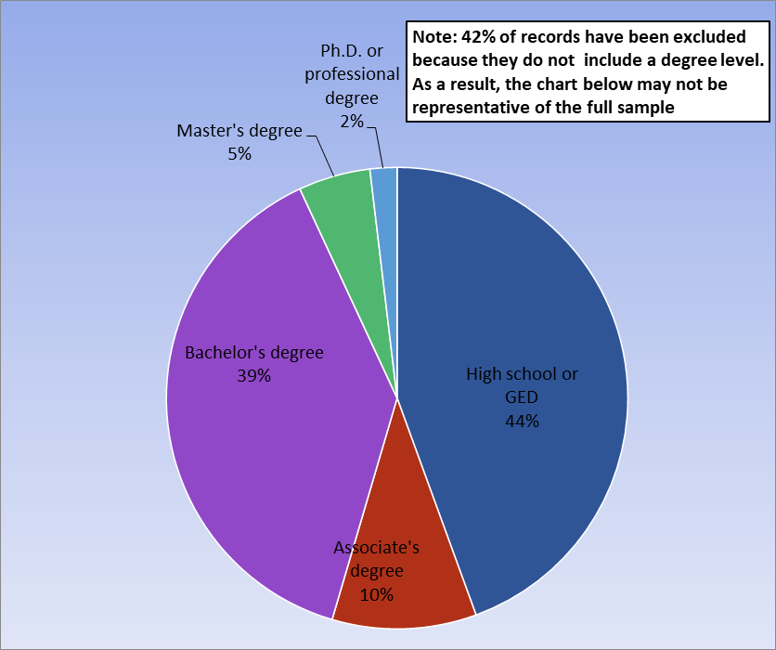
Connecticut Job Ads by Educational Requirements
Connecticut Department of Labor – Research Office 200 Folly Brook Blvd. Wethersfield, CT 06109
Help Wanted Online

Slide 13
Workforce Area Data
Workforce Area Highlights
Job Ads by Industry
Job Ads by Location
Employers With The Most Job Ads
Occupations With The Most Job Ads
Connecticut Department of Labor – Research Office 200 Folly Brook Blvd. Wethersfield, CT 06109
Help Wanted Online

Slide 14
Workforce Area Highlights
Connecticut Department of Labor – Research Office 200 Folly Brook Blvd. Wethersfield, CT 06109
Help Wanted Online

Slide 15
Connecticut Department of Labor – Research Office 200 Folly Brook Blvd. Wethersfield, CT 06109
Help Wanted Online

Slide 16
Eastern Workforce Job Ads by Location
Connecticut Department of Labor – Research Office 200 Folly Brook Blvd. Wethersfield, CT 06109
Help Wanted Online

Slide 17
Eastern Workforce Employers
with the Most Job Ads
Connecticut Department of Labor – Research Office 200 Folly Brook Blvd. Wethersfield, CT 06109
Help Wanted Online

Slide 18
Eastern WDA Occupations
with the Most Job Ads
Connecticut Department of Labor – Research Office 200 Folly Brook Blvd. Wethersfield, CT 06109
Help Wanted Online

Slide 19
Connecticut Department of Labor – Research Office 200 Folly Brook Blvd. Wethersfield, CT 06109
Help Wanted Online
19

Slide 20
North Central WDA Job Ads by Location
Connecticut Department of Labor – Research Office 200 Folly Brook Blvd. Wethersfield, CT 06109
Help Wanted Online

Slide 21
North Central WDA Employers
with the Most Job Ads
Connecticut Department of Labor – Research Office 200 Folly Brook Blvd. Wethersfield, CT 06109
Help Wanted Online

Slide 22
North Central WDA Occupations
with the Most Job Ads
Connecticut Department of Labor – Research Office 200 Folly Brook Blvd. Wethersfield, CT 06109
Help Wanted Online

Slide 23
Connecticut Department of Labor – Research Office 200 Folly Brook Blvd. Wethersfield, CT 06109
Help Wanted Online

Slide 24
Northwest WDA Job Ads by Location
Connecticut Department of Labor – Research Office 200 Folly Brook Blvd. Wethersfield, CT 06109
Help Wanted Online

Slide 25
Northwest WDA Employers
with the Most Job Ads
Connecticut Department of Labor – Research Office 200 Folly Brook Blvd. Wethersfield, CT 06109
Help Wanted Online

Slide 26
Northwest WDA Occupations
with the Most Job Ads
Connecticut Department of Labor – Research Office 200 Folly Brook Blvd. Wethersfield, CT 06109
Help Wanted Online

Slide 27
Connecticut Department of Labor – Research Office 200 Folly Brook Blvd. Wethersfield, CT 06109
Help Wanted Online

Slide 28
South Central WDA Job Ads by Location
Connecticut Department of Labor – Research Office 200 Folly Brook Blvd. Wethersfield, CT 06109
Help Wanted Online

Slide 29
South Central WDA Employers
with the Most Job Ads
Connecticut Department of Labor – Research Office 200 Folly Brook Blvd. Wethersfield, CT 06109
Help Wanted Online

Slide 30
South Central WDA Occupations
with the Most Job Ads
Connecticut Department of Labor – Research Office 200 Folly Brook Blvd. Wethersfield, CT 06109
Help Wanted Online

Slide 31
Connecticut Department of Labor – Research Office 200 Folly Brook Blvd. Wethersfield, CT 06109
Help Wanted Online

Slide 32
Southwest WDA Job Ads by Location
Connecticut Department of Labor – Research Office 200 Folly Brook Blvd. Wethersfield, CT 06109
Help Wanted Online

Slide 33
Southwest WDA Employers
with the Most Job Ads
Connecticut Department of Labor – Research Office 200 Folly Brook Blvd. Wethersfield, CT 06109
Help Wanted Online

Slide 34
Southwest WDA Occupations
with the Most Job Ads
Connecticut Department of Labor – Research Office 200 Folly Brook Blvd. Wethersfield, CT 06109
Help Wanted Online

Slide 35
All advertisement data used in this publication is from the Conference Board’s Help Wanted Online data series.
For more information or data requests, contact Matthew Krzyzek in the Office of Research at the Department of Labor.
Matthew.Krzyzek@ct.gov
For more Connecticut Labor Market Information visit:
www.ctdol.state.ct.us/lmi
https://www.facebook.com/ctlmi
Twitter: @DOL_Research
Connecticut Department of Labor – Research Office 200 Folly Brook Blvd. Wethersfield, CT 06109
Help Wanted Online

